Slide 1
Quantum Theory and the Electronic Structure of Atoms Chapter 7 Dr. Sultana Bedoura

Slide 2
Introduction
Quantum theory enables us to understand the critical role that electrons play in chemistry
Studying atoms leads to the following questions:
How many electrons are present in a particular atom?
What energies do individual electrons possess?
Where in the atom can electrons be found?
The answer to these questions have a direct relationship to the behavior of all substances in chemical reactions

Slide 3
From Classical Physics to Quantum Theory
By assuming that molecules behave like rebounding balls, physicists were able to predict and explain some macroscopic phenomena
Such as pressure exerted by a gas
This model did not account for the stability of molecules; that is, it could not explain the forces that hold atoms together
It was realized that the properties of atoms and molecules are not governed by the same physical laws as larger objects

Slide 4
From Classical Physics to Quantum Theory
The new era in physics started in 1900 with a young German physicist named Max Planck
While studying the data on radiation emitted by solids heated to various temperatures, Planck discovered that atoms and molecules emit energy only in certain discrete quantities, or quanta
Physicists had always assumed that energy is continuous and that any amount of energy could be released in a radiation process
Planck’s quantum theory turned physics upside down

Slide 5
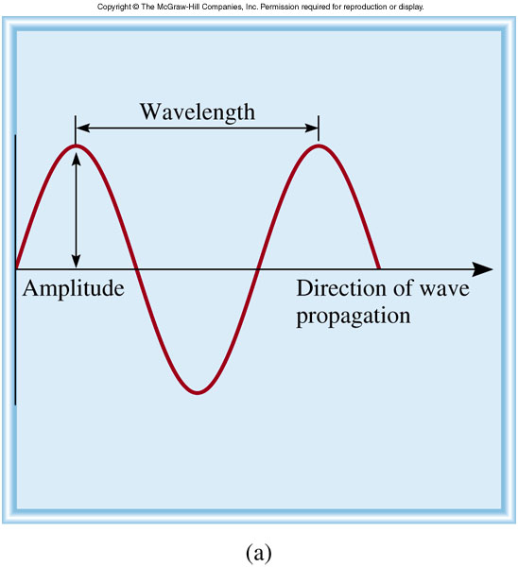
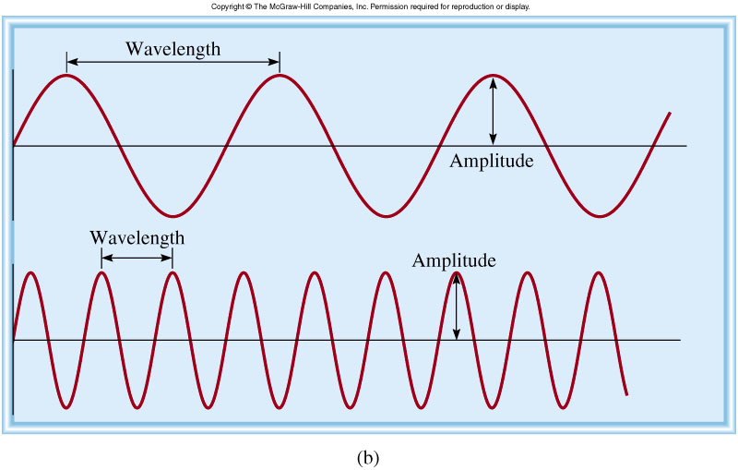
Properties of Waves
Wavelength (λ) is the distance between identical points on successive waves
Amplitude is the vertical distance from the midline of a wave to the peak or trough
Frequency (ν) is the number of waves that pass through a particular point in 1 second (Hz = 1 cycle/s)
The speed (u) of the wave = λν

Slide 6
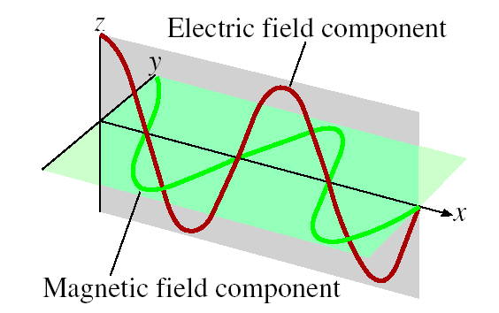
Electromagnetic Radiation
Electromagnetivc radiation
is the emission and
transmission of energy
in the form of
electromagnetic waves
James Clerk Maxwell (1873),
proposed that visible light
consists of electromagnetic waves
Speed of light (c) in vacuum = 3.00 x 10⁸ m/s
All electromagnetic radiation
λν = c

Slide 7
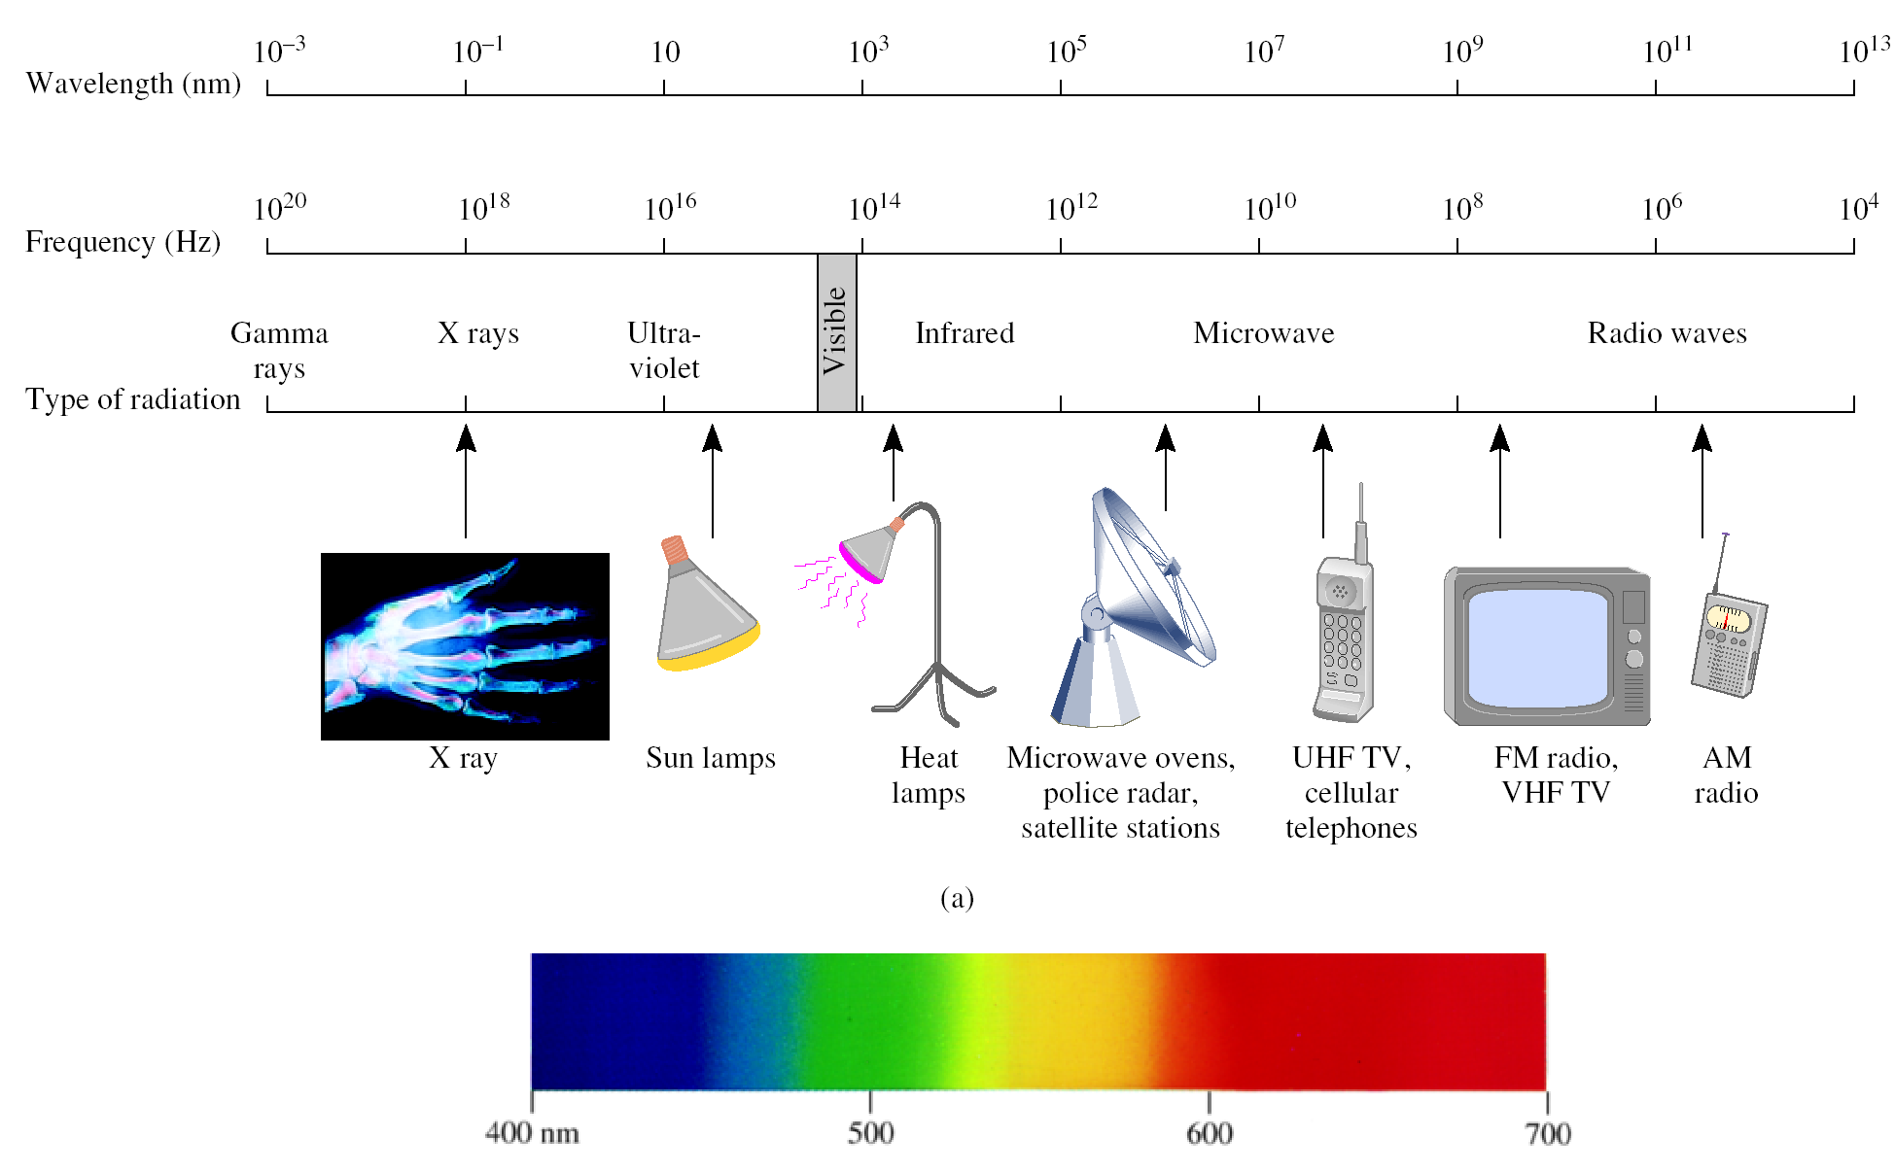
Types of Electromagnetic Radiation
VIBGYOR

Slide 8
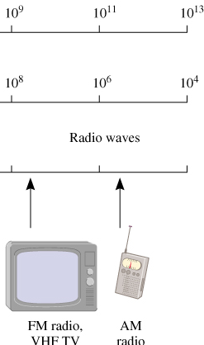
Problem
A photon has a frequency of 6.0 x 10⁴ Hz. Convert this frequency into wavelength (nm). Does this frequency fall in the visible region?
λ
ν
λν = c
⇒λ = c/ν
= 3.00 x 10⁸ m/s / 6.0 x 10⁴ Hz
= 5.0 x 10³ m
= 5.0 x 10¹² nm

Slide 9
Planck’s Quantum Theory
When solids are heated, they emit electromagnetic radiation over a wide range of wavelengths
Radiant energy emitted by an object at a certain temperature depends on its wavelength
Energy (light) is emitted or absorbed only in discrete quantities, like small packages or bundles (quantum)
Quantum: the smallest quantities of energy that can be emitted (or absorbed) in the form of electromagnetic radiation
The energy E of a single quantum of energy is
E = h x ν
Where, h = Planck’s constant

Slide 10
Planck’s Quantum Theory
The energy E of a single quantum of energy is
E = h x ν
h = 6.63 x 10⁻³⁴ J•s, Planck’s constant
ν = frequency of radiation
Because c = νλ or ν = c / λ,
so, E = hc / λ
According to quantum theory, energy is always emitted in multiple of hν; e.g., hν, 2hν , 3hν….. but never 1.67 hν or 4.98 hν

Slide 11



Analogies of Concept of Quantization
Matter is quantized, number of electrons,
protons and neutrons and numbers of
atoms must be integers
Money system is based on
“quantum” of value called
“paisa”
Hens lay ‘quantized’ eggs
A pregnant cat give birth to
an integer number of kittens,
not to one-half or three-quarters of a kitten
Concept of quantization has many analogies:

Slide 12
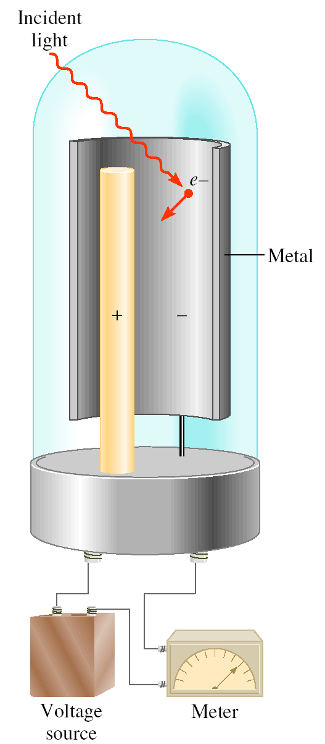
Photoelectric Effect
Photoelectric effect: a phenomenon in which electrons are ejected from the surface of certain metals exposed to light of at least a certain minimum frequency, called the threshold frequency
The number (not energies) of electrons ejected was proportional to the intensity of the light
Light is a stream of particles called photons and they have both wave and particle nature
Einstein deduced that each photon must possess energy, E = h x ν

Slide 13
Photoelectric Effect
If E_{Photon} = W*
then, the light will have just enough energy to knock the electrons loose
If E_{Photon} >W
then, not only will the electrons be knocked
loose, but they will also acquire some KE**
E_{Photon} = hν = W +KE
The more energetic the photon ( higher the frequency), the greater the KE of the ejected electron
*W =work function→ how strongly electrons are held in metal
**KE= kinetic energy

Slide 14
Problem
When copper is bombarded with high-energy electrons, X-rays are emitted. Calculate the energy (in joules) associated with the photons if the wavelength of the X-ray is 0.154 nm.
E = hν
= hc / λ
= 6.63 x 10⁻³⁴ (J•s) x 3.00 x 10 ⁸ (m/s) / 0.154 x 10⁻⁹ (m)
= 1.29 x 10 ⁻¹⁵ J

Slide 15
Problem
The work function of cesium metal is 3.42x10⁻¹⁹ J. (a) Calculate the minimum frequency of light required to release electrons from the metal. (b) Calculate the kinetic energy of the ejected electron if light of frequency 1.00x10¹⁵ s⁻¹ is used for irradiating the metal.
(a)
(b)
E = hν = W+ KE
E_{min} = hν_{min} = W
ν_{min} = W/h = 3.42x10⁻¹⁹ J/6.63 x 10⁻³⁴ (J•s)
= 5.16 x 10 ¹⁴ s⁻¹
E = hν = W+ KE
KE = hν − W
KE = (6.63 x 10⁻³⁴ J•s x 1.00x 10¹⁵ s⁻¹) - 3.42x10⁻¹⁹ J
= 3.21 x 10⁻¹⁹ J

Slide 16
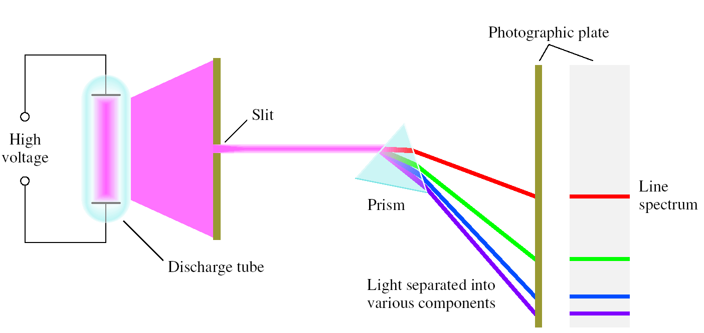
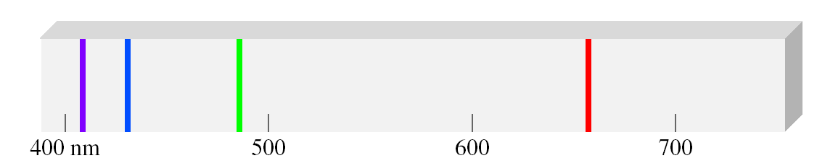
Line Emission Spectrum of Hydrogen Atoms
Every element has a unique emission spectrum
The characteristic lines in atomic spectra can be used in chemical analysis to identify unknown atoms

Slide 17
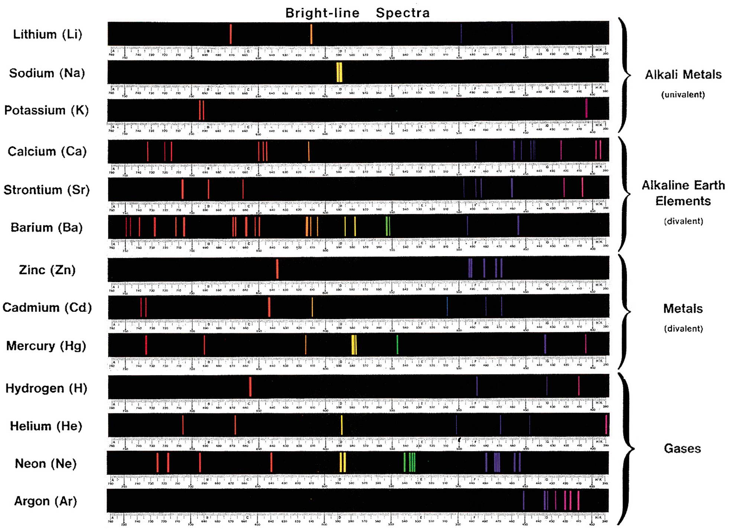
Line Spectra

Slide 18
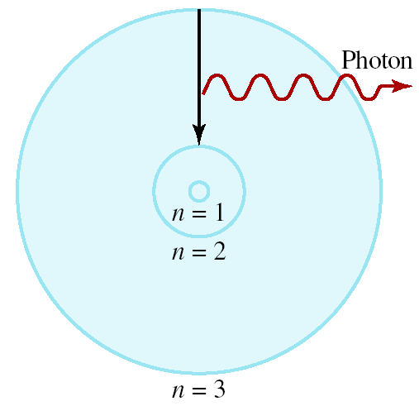
Bohr’s Model of the Atom
Bohr postulated that-
The energies of the electron are quantized
Light is emitted as e⁻ moves from higher energy level to a lower energy level
Energies of an electron in hydrogen
atom can occupy
Where,
R_{H} (Rydberg constant) = 2.18 x 10⁻¹⁸J
n (principal quantum number) = 1, 2, 3,…
1
E_{n} = -R_{H}
( )
n²

Slide 19
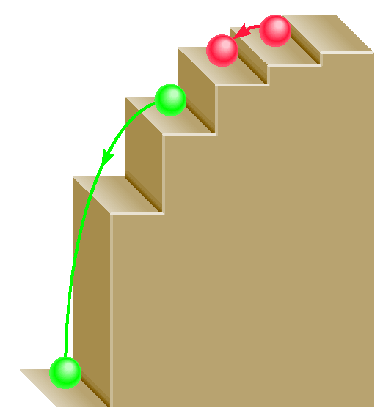
Bohr’s Model of the Atom
The amount of energy needed to move an electron in the Bohr atom depends
on the difference in energy levels between the initial and final states
E_{Photon} = ΔE = E_{f} – E_{i}
When a photon is emitted, n_{i} > n_{f} ; so,
E = hν
1
E = hν
E_{f} = -R_{H}
( )
n²
f
1
E_{i} = -R_{H}
( )
n²
i
1
1
ΔE = R_{H}
( )
n²
n²
i
f
ΔE is negative

Slide 20
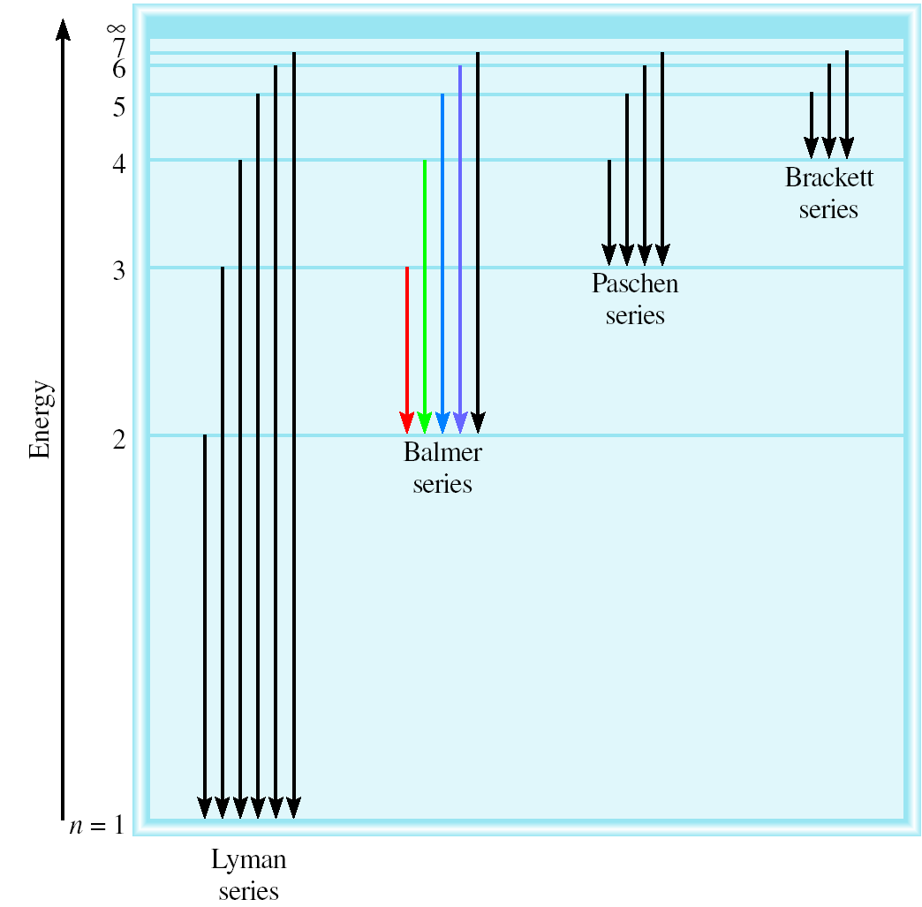

The Energy Levels and Emission Series of H
n_{i} = 3
n_{i} = 3
n_{i} = 2
n_{f} = 2
n_{f} = 1
n_{f} = 1

Slide 21
Problem
Calculate the wavelength (in nm) of a photon emitted by a hydrogen atom when its electron drops from the n = 5 state to the n = 3 state.
1
1
E_{photon} =
ΔE = R_{H}
( )
n²
n²
i
f
= 2.18 x 10⁻¹⁸ J x (1/25 - 1/9)
= -1.55 x 10⁻¹⁹ J (emission of photon)
E_{photon} = hc / λ
λ = hc / E_{photon}
= 6.63 x 10⁻³⁴ (J•s) x 3.00 x 10⁸ (m/s)/1.55 x 10⁻¹⁹J
= 1280 nm

Slide 22
Problem
An electron in the hydrogen atom makes a transition from an energy state of principal quantum numbers into the n=2 state. If the photon emitted has a wavelength of 434 nm, what is the value of n_{i}? (R_{H}= 2.18 X 10⁻¹⁸ J)

Slide 23
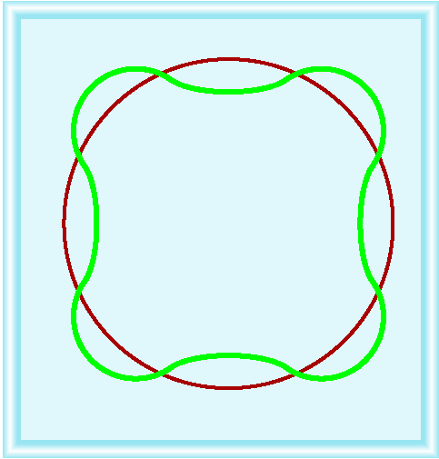
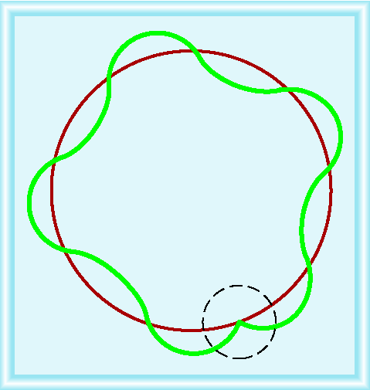
The Dual Nature of the Electron
Why is electron energy quantized?
De Broglie argued, an e⁻ does behave like a standing wave
He reasoned that waves can behave like particles and particles can exhibit wave like properties
2πr = nλ r = radius of the orbit
n= integer , λ=wavelength of e⁻
Allowed orbit
h
λ = m,u = mass & velocity of e⁻
mu
Wave like property
Particle like property
Nonallowed orbit

Slide 24
Problem
What is the de Broglie wavelength (in nm) associated with a 2.5 g Ping-Pong ball traveling at 15.6 m/s?
(1 J =1 kg m² /s² )
λ = h/mu
Here,
h= 6.63x 10⁻³⁴ J.s
m= 2.5x 10⁻³ kg
u= 15.6 m/s
λ = 6.63 x 10⁻³⁴ / (2.5 x 10⁻³ x 15.6)
= 1.7 x 10⁻³² m = 1.7 x 10⁻²³ nm
**m and u must be in kg and m/s

Slide 25
Quantum Mechanics
Bohr’s approach did not account for the emission spectra of atoms containing more than one electrons (He, Li)
When electrons are wavelike, how can the “position” of a wave be specified?
To describe the problem of trying to locate a subatomic particle that behaves like a wave, Werner Heisenberg formulated the Heisenberg uncertainty principle
It is impossible to know simultaneously both the momentum (defined as mass times velocity) and the position of a particle with certainty

Slide 26
Heisenberg Uncertainty Principle
“It is impossible to know simultaneously both the momentum (defined as mass times velocity) and the position of a particle with certainty”
where, Δx is the uncertainties in measuring the position, and Δp is the uncertainties in measuring the momentum
In reality the electron does not orbit the nucleus in a well-defined path, as Bohr thought

Slide 27

Schrodinger Wave Equation
In 1926 Schrodinger wrote an equation that described both the particle and wave nature of the e⁻
Eψ = Hψ
Wave function (ψ) describes:
energy of e⁻ with a given ψ
ψ ² probability of finding e⁻
in a volume of space
Schrodinger’s equation can only be solved exactly for the hydrogen atom. Must approximate its solution for multi-electron systems

Slide 28
Quantum Numbers
ψ is a function of three numbers called quantum numbers (n, l, m_{l}, m_{s})
3 quantum numbers are required to describe the distribution of electrons in hydrogen and other atoms
The principal quantum number, n
-It expresses distance of e⁻ from the nucleus
The angular momentum quantum number, l
-It represents the shape of the “volume” of space that e- occupies
The magnetic quantum number, m_{l}
-It represents the orientation of the orbital in space
The electron spin quantum number, m_{s}

Slide 29
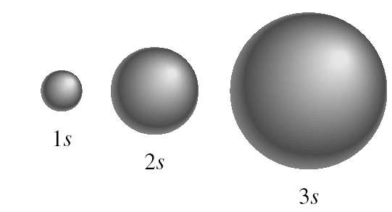
Principal Quantum Numbers
The principal quantum number, n
In a hydrogen atom, the value of n determines the energy of an orbital. n = 1, 2, 3, 4, ….
It also relates to the average distance of the electron from the nucleus in a particular orbital.
The larger n is, the greater the average distance of an electron in the orbital from the nucleus and therefore the larger the orbital.
n=1
n=2
n=3

Slide 30

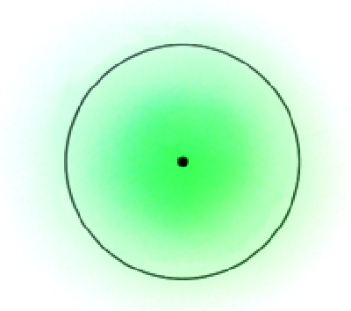
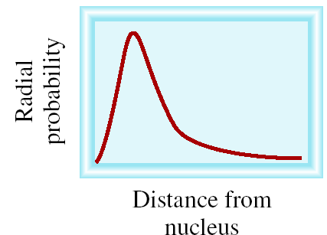
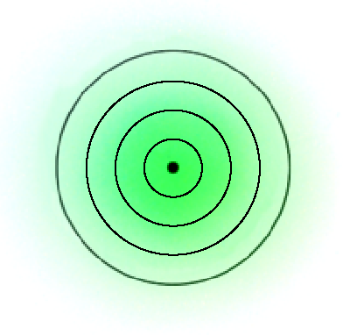
Principal Quantum Numbers
Where 90% of the
e⁻ density is found
for the 1s orbital

Slide 31

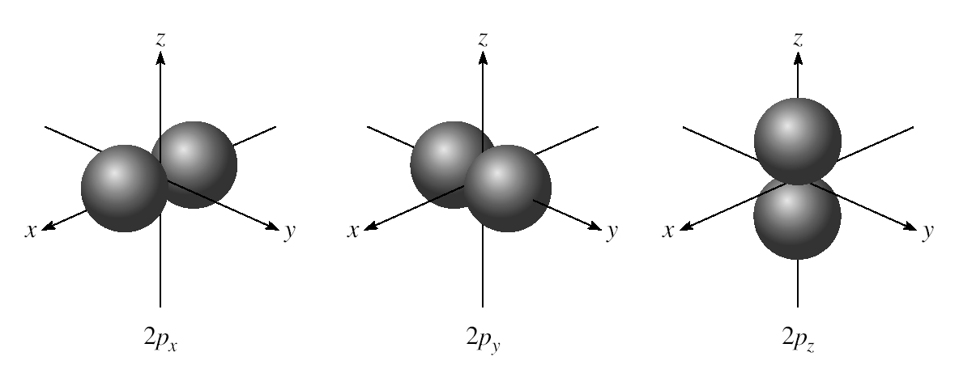
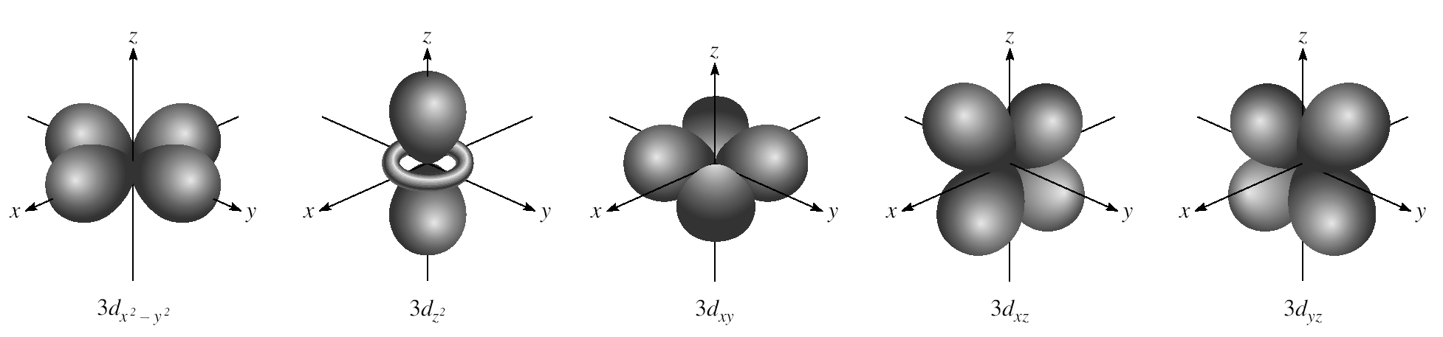
Angular Momentum Quantum Numbers
For a given value of n, the angular momentum quantum number, l = 0, 1, 2, 3, … n-1
n = 1, l = 0
n = 2, l = 0 or 1
n = 3, l = 0, 1, or 2
s orbitals
l = 0 s orbital
l = 1 p orbital
l = 2 d orbital
l = 3 f orbital
p orbitals
d orbitals

Slide 32
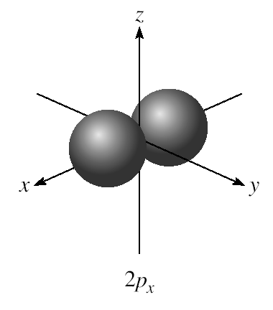
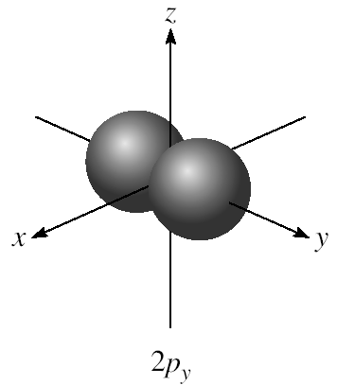
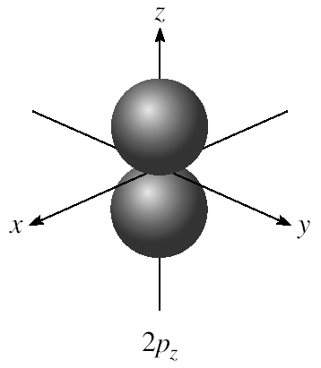
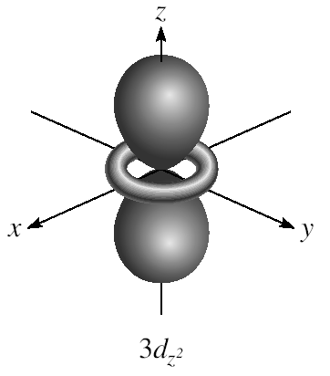
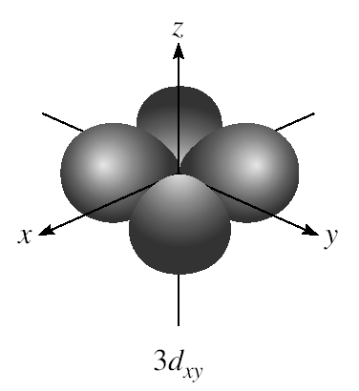
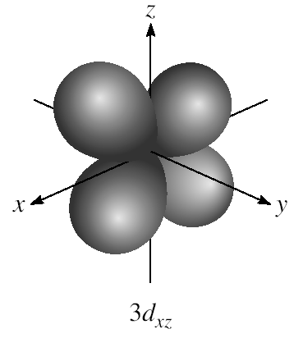
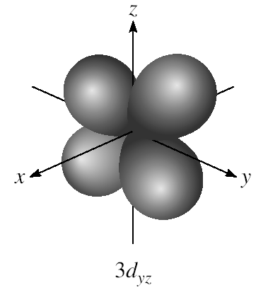
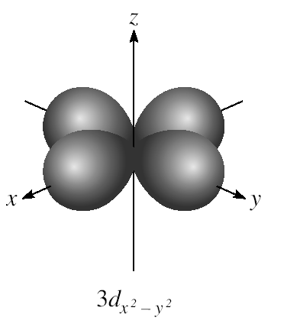
Magnetic Quantum Numbers
For a given value of l, the magnetic quantum number,
m_{l} = - l, …., 0, …. + l
Example: if l = 1 (p orbital), m_{l} = -1, 0, or 1
if l = 2 (d orbital), m_{l} = -2, -1, 0, 1, or 2
m_{l} = -1, 0, or 1
3 orientations is space
m_{l} = -2, -1, 0, 1, or 2
5 orientations is space

Slide 33
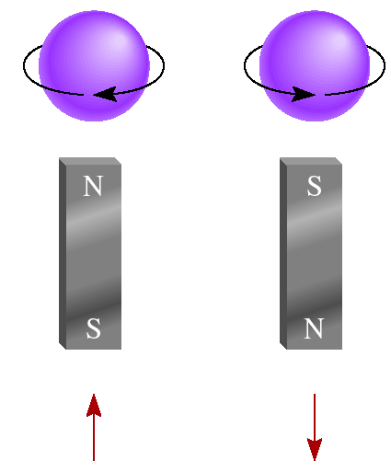
Electron Spin Quantum Numbers
spin quantum number,
m_{s} = +½ or -½
m_{s} = +½
m_{s} = -½

Slide 34
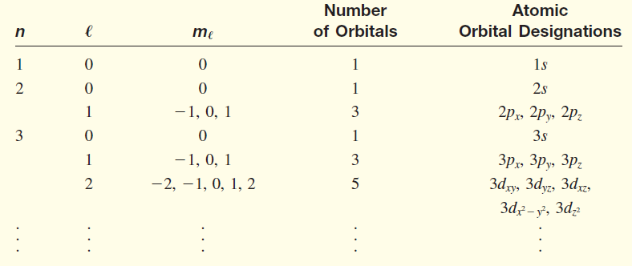
Quantum Numbers and Atomic Orbitals

Slide 35


The Pauli Exclusion Principle
“No two electrons in an atom can have the same set of four quantum numbers”
If two electrons in an atom should have the same n , l , and m_{l} values then they must have different values of m_{s}.

Slide 36
Quantum Numbers and Atomic Orbitals
Quantum numbers: (n, l, m_{l}, m_{s})
Shell – electrons with the same value of n
Subshell – electrons with the same values of n and l
Orbital – electrons with the same values of n, l, and m_{l}
How many electrons can an orbital hold?
If n, l, and m_{l} are fixed, then m_{s} = ½ or - ½
ψ = (n, l, m_{l}, ½)
Or ψ = (n, l, m_{l}, -½)
An orbital can hold 2 electrons

Slide 37

Class Work
How many 2p orbitals are there in an atom?
n=2
If l = 1, then m_{l} = -1, 0, or +1
2p
3 orbitals
l = 1
How many electrons can be placed in the 3d subshell?
n=3
If l = 2, then m_{l} = -2, -1, 0, +1, or +2
3d
5 orbitals which can hold a total of 10 e⁻
l = 2

Slide 38
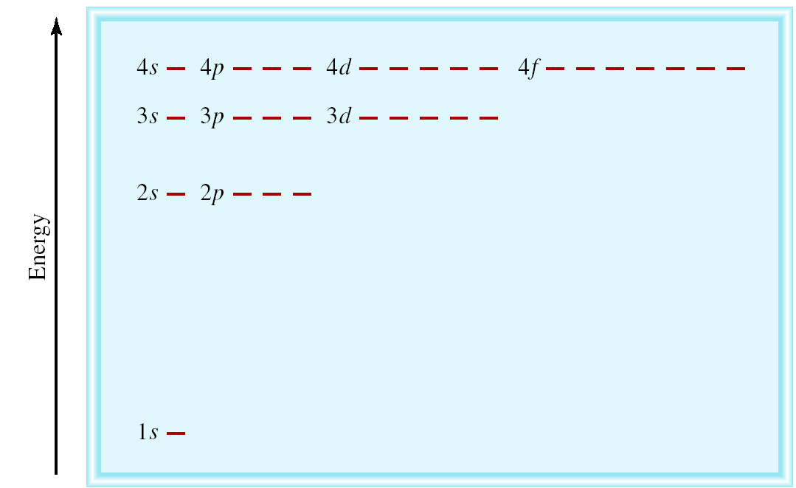
Energy of Orbitals in a Single Electron Atom
Energy only depends on principal quantum number n
n=3
n=2
1
E_{n} = -R_{H}
( )
n²
n=1

Slide 39
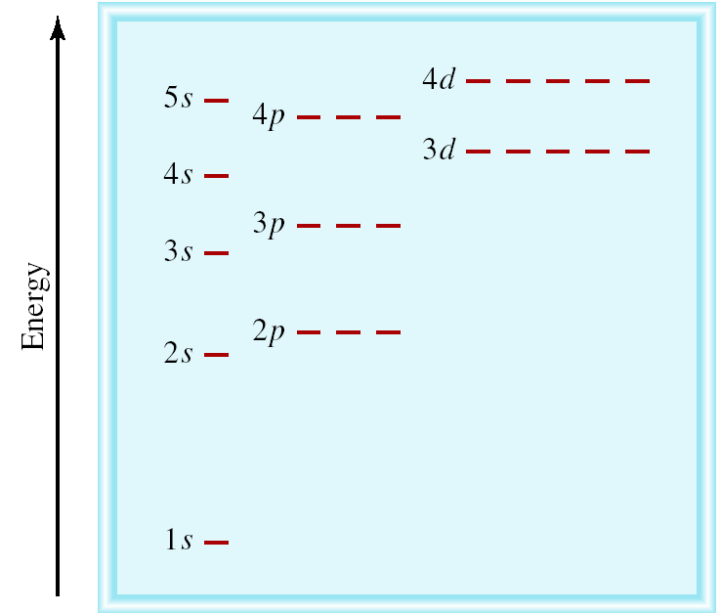
Energy of Orbitals in a Multi-electron Atom
Energy depends on n and l
n=3 l = 2
n=3 l = 1
n=3 l = 0
n=2 l = 1
n=2 l = 0
n=1 l = 0

Slide 40

Aufbau Principle
“Fill up” electrons in lowest energy orbitals (Aufbau principle)
?
?
Li 3 electrons
Be 4 electrons
B 5 electrons
C 6 electrons
B 1s²2s²2p¹
Be 1s²2s²
Li 1s²2s¹
H 1 electron
He 2 electrons
He 1s²
H 1s¹

Slide 41

Hund’s Rule
“The most stable arrangement of electrons in subshells is the one with the greatest number of parallel spins. ”
The electron configuration of carbon ( Z = 6) is 1s²s²2p² . The following are different ways of distributing two electrons among three p orbitals:

Slide 42
Hund’s Rule
C 6 electrons
N 7 electrons
O 8 electrons
F 9 electrons
Ne 10 electrons
Ne 1s²2s²2p⁶
C 1s²2s²2p²
N 1s²2s²2p³
O 1s²2s²2p⁴
F 1s²2s²2p⁵

Slide 43
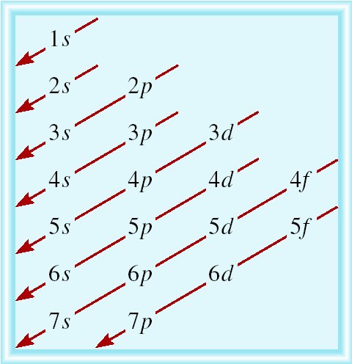
Order of Orbitals in multi-electron atom
1s < 2s < 2p < 3s < 3p < 4s < 3d < 4p < 5s < 4d < 5p < 6s

Slide 44
Electron configuration
Electron configuration is how the electrons are distributed among the various atomic orbitals in an atom.
number of electrons
in the orbital or subshell
1s¹
principal quantum
number n
angular momentum
quantum number l
Orbital diagram
H
1s¹

Slide 45
Tasks
What is the electron configuration of Mg?
Mg 12 electrons
1s < 2s < 2p < 3s < 3p < 4s
1s²2s²2p⁶3s²
2 + 2 + 6 + 2 = 12 electrons
Abbreviated as [Ne]3s²
[Ne] 1s²2s²2p⁶
What are the possible quantum numbers for the last (outermost) electron in Cl?
Cl 17 electrons
1s < 2s < 2p < 3s < 3p < 4s
1s²2s²2p⁶3s²3p⁵
2 + 2 + 6 + 2 + 5 = 17 electrons
Last electron added to 3p orbital
n = 3
l = 1
m_{l} = -1, 0, or +1
m_{s} = ½ or -½

Slide 46
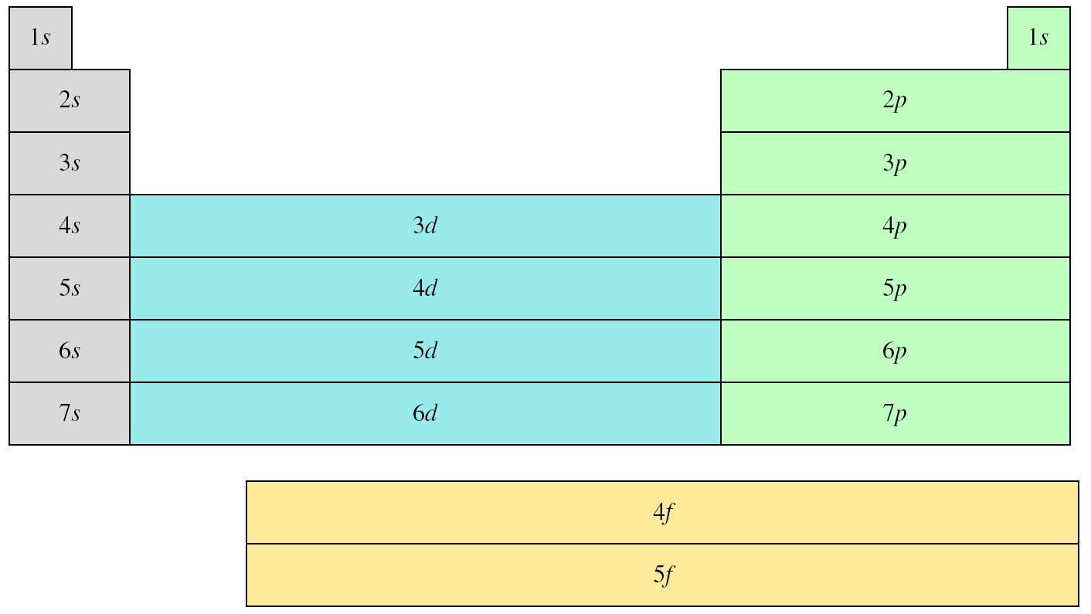
Outermost subshell being filled with electrons

Slide 47
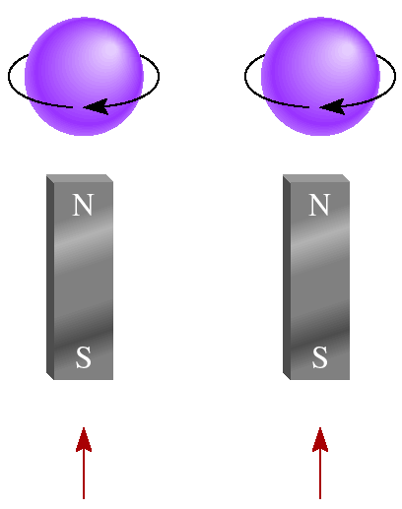
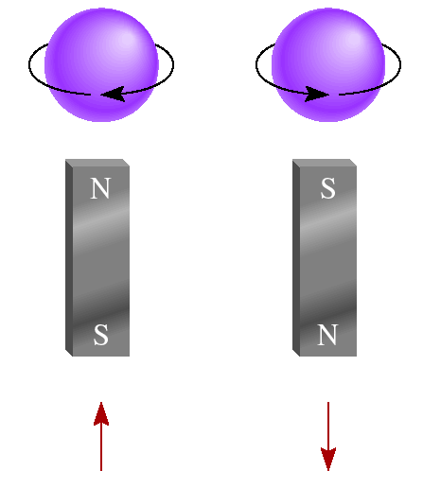
Paramagnetic and Diamagnetic Properties
Paramagnetic
Diamagnetic
unpaired electrons
all electrons paired
2p
2p

Slide 48
Thank You

